Slide 1
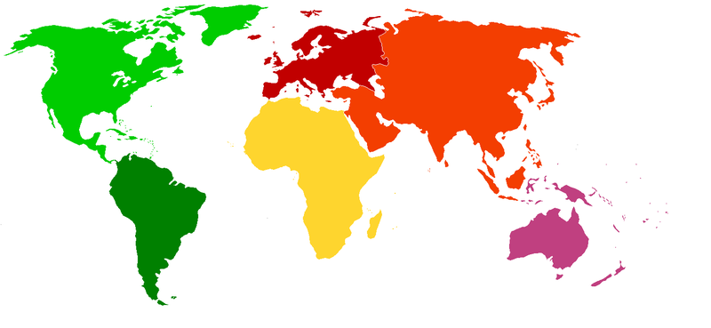
Geography
This half term we will be taking a close look at where the countries of the world are located, in addition to some of the ways geographers describe locations. We will learn to locate countries using longitude and latitude, and find out about the significance of the Equator, the Hemispheres and the Tropics. We will identify differences that exist between the UK and the Tropics, by learning about the meaning and importance of climate.
English
Our class text in Autumn 2 will be written by Vivian French and will be introduced to the class as we start the half-term. We will use this text to facilitate our whole class guided reading sessions, in addition to inspiring our writing opportunities. We will explore writing for different audiences and purposes, with a focus on writing to entertain and inform. We will produce a narrative piece of writing in addition to a newspaper article. We will then move on to something more festively focussed towards the end of the half term.
D&T
In D&T this half term we will be investigating mechanical systems, focusing on levers and linkages. We will explore mechanisms such as flaps, sliders and levers, and gain experience in cutting, joining and finishing techniques.
Science
Within Science, we will explore light, reflection and shadows. We will be looking at different light sources, investigating reflective materials and observing how shadows can change depending on the distance of the light source.
Where are we?
YEAR 3 AUTUMN TERM 2
CURRICULUM MAP 2022
PE
In addition to our weekly slots with NUFC PE, we will be focusing on the skills needed to be successful in Dodgeball. We will improve our throwing and catching techniques, in addition to learning different dodging techniques needed to be an effective dodgeball player!
Computing
In Computing we will focus on coding. Using Purple Mash software, we will learn how to design and create an interactive scene.
Music
We will continue with our weekly Ukulele sessions, in addition to our lessons with Mrs Milner.
Maths
We will continue to focus on addition and subtraction methods after the half term, before moving onto multiplication and division. We will also continue to work through our times tables using Times Table Rock Stars and will use SUMDOG.
P.S.H.C.E and RE
Our RE lessons this half term will centre around the key question: “What does it mean to be a Hindu in Britain today?” We will explore key aspects of Hindu belief and worship, learn about spiritual practices, and understand how Hindus show their faith.
Our PSHE will focus on team building, overcoming challenges and celebrating our strengths.
French
In French lessons, we will continue to progress our knowledge of numbers. We will practice numbers from 1 to 31, in addition to learning the days and months.

